Slide 1
Probability Distributions
Discrete and Continuous

Slide 2


Probability Distribution
PROBABILITY DISTRIBUTION: A listing of all the outcomes of an experiment and the probability associated with each outcome.
Probability distribution: tells us how the total probability is distributed over the different values of the RV.
CHARACTERISTICS OF A PROBABILITY DISTRIBUTION
The probability of a particular outcome is between 0 and 1 inclusive,
The outcomes are mutually exclusive events.
The list is exhaustive. So the sum of the probabilities of the various events is equal to 1, .
6-<number>

Slide 3
Important Probability Distribution:
Discrete: Binomial, Poisson, Geometric, Negative Binomial, Multinomial, etc.
Continuous: Uniform, Exponential, Normal, Gamma, Beta, Weibull, t, F, Chi-square, etc.
The following are commonly used sampling distributions (probability distribution of statistics):
t-distribution is used in hypothesis testing when the sample size is small or the population standard deviation is unknown.
F distribution arises in variance analysis (ANOVA) and regression analysis.
Chi-square distribution is commonly used to assess the goodness of fit of observed data with expected distributions or test the independence of categorical variables.

Slide 4
Random Variables
RANDOM VARIABLE: A quantity resulting from an experiment that, by chance, can assume different values.
Two types of Random Variable
DISCRETE RANDOM VARIABLE can assume only certain clearly separated values. It is usually the result of counting something.
CONTINUOUS RANDOM VARIABLE can assume an infinite number of values within a given range. It is usually the result of some type of measurement.
EXAMPLES
The length of each song on the latest album.
The weight of each student in this class.
The temperature outside as you are reading this book.
The amount of money earned by a football club.
EXAMPLES
The number of students in a class.
The number of children in a family.
The number of cars entering a carwash in a hour.
Number of home mortgages approved by a particular bank
6-<number>

Slide 5
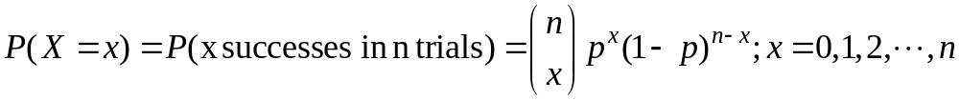
The Binomial Probability Distribution
Consider an experiment consisting of
n (fixed) Bernoulli trials (whose only possible values are 0 and 1)
that are independent
that each has a constant probability p of success and
that each trial must result in a success or failure..
Then, the total number of successes X is a random variable that has a binomial distribution with parameters n and p, which is written X ∼ B(n, p).
The probability mass function of a B(n, p) random variable is
Properties:
1. If p = 0.5, binomial distribution is symmetric about n/2..
2. Mean = E(X) = np, and 3. Variance =V(X) = npq (mean>variance)

Slide 6
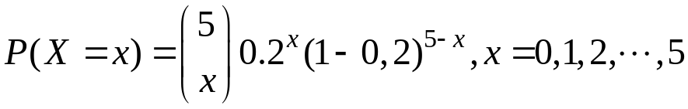
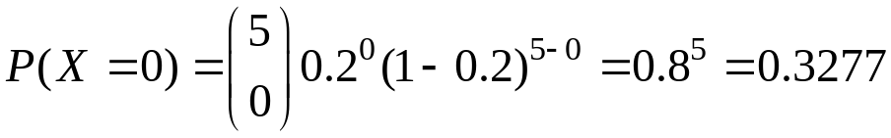
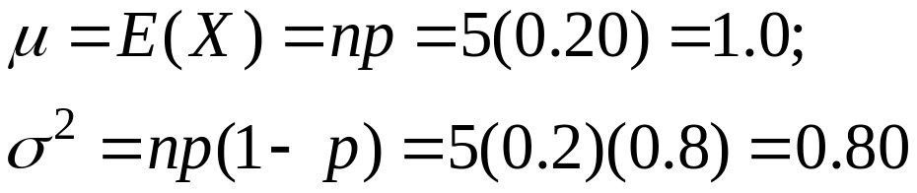
Binomial Probability Distribution
EXAMPLE 1
There are five flights daily from Pittsburgh via US Airways into the Bradford, Pennsylvania, Regional Airport. Suppose the probability that any flight arrives late is .20.
(a) What is the probability that none of the flights are late today?
(b) What is the average number of late flights? What is the variance of the number of late flights?
Solution: X = no of flights arrive late. X~B(n = 5, p=0.20)
(a)
(b)
6-<number>

Slide 7
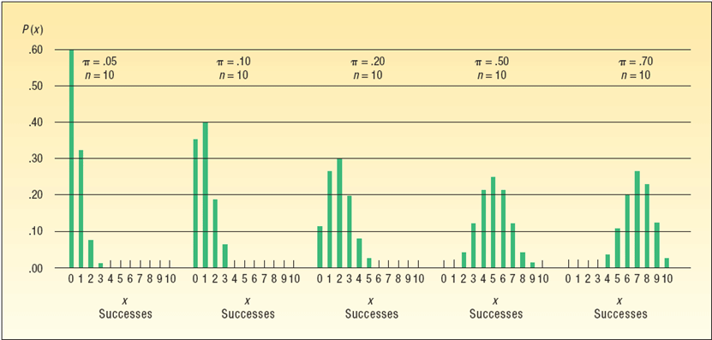

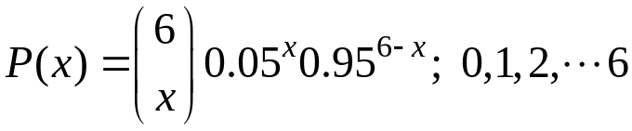
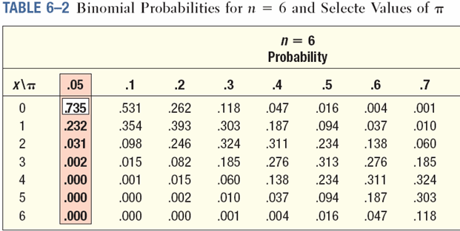
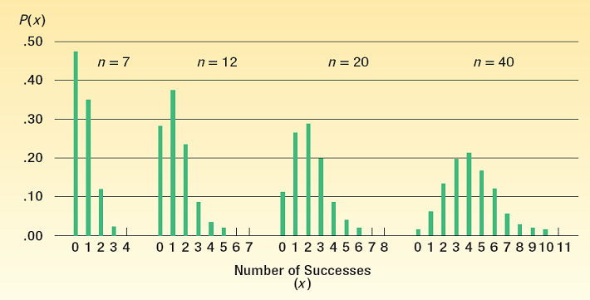
Binomial Distribution - Example
EXAMPLE 2
Five percent of the worm gears produced by an automatic, high-speed Carter-Bell milling machine are defective.
What is the probability that out of six gears selected at random none will be defective? Exactly one? Exactly two? Exactly three? Exactly four? Exactly five? Exactly six out of six?
Solution: X = no of defective gears
, X~B(n=6, p=0.05)
P(X=0)=0.735; P(X=1) = 0.232, P(X=2)=0.031; P(X=3) 0.002;P(X=4) = 000
Binomial – Shapes for Varying π (n constant)
Binomial – Shapes for Varying n (π constant)
6-<number>

Slide 8

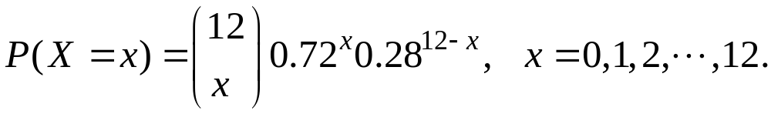
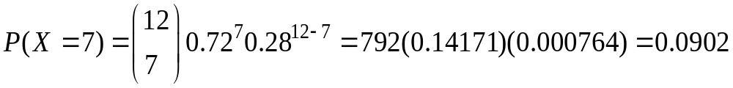
Cumulative Binomial Probability Distributions
EXAMPLE 3
A study by the Illinois Department of Transportation concluded that 76.2 percent of front seat occupants used seat belts. A sample of 12 vehicles is selected.
(a) What is the probability the front seat occupants in exactly 7 of the 12 vehicles are wearing seat belts?
(b) What is the probability the front seat occupants in at least 7 of the 12 vehicles are wearing seat belts?
(a) X be the number of front seat occupants use seat belts.
The pmf of X is
(a)
(b)
6-<number>

Slide 9
Poisson Probability Distribution
The Poisson distribution was first derived in 1837 by the French
mathematician Simeon Denis Poisson whose main work was on
the mathematical theory of electricity and magnetism.
The distribution arises when the events being counted occur
(a) independently;
(b) such that the probability that two or more events occur simultaneously is zero;
(c) randomly in time or space;
(d) uniformly (that is, the mean number of events in an interval is directly proportional to the length of the interval).
The Poisson probability distribution describes the number of times some event occurs during a specified interval. The interval may be time, distance, area, or volume.
6-<number>

Slide 10
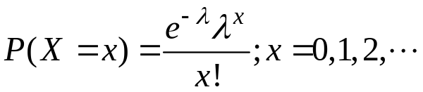

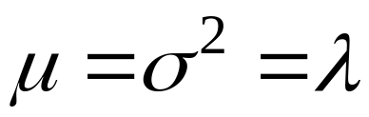
Poisson Distribution
The pmf of a Poisson Distribution with parameter :
is the mean number of occurrences (successes) in a particular interval.
x is the number of occurrences (successes)
P(x) is the probability for a specified value
Assumptions of the Poisson Distribution
The probability is proportional to the length of the interval.
The intervals are independent.
Examples:
1. The number of bacteria in a biological event
2. The number of vehicles sold per day at a particular car company
3. The number of deaths in a given period, by rare disease.
4. The number of error per page in typed material.
5. The number of plants infected with a particular disease in a plot of field.
6. The number of weeds in particular species in different plots of a field
7. The number of misspelled words per page in a standard book.

Slide 11
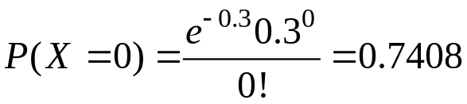
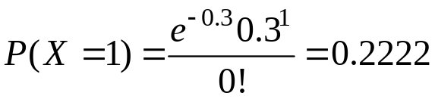
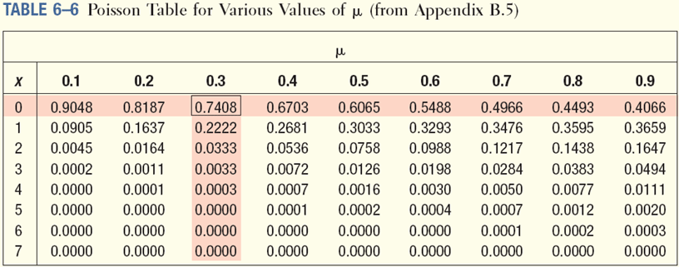
Poisson Probability Distribution - Example
EXAMPLE 1
Assume baggage is rarely lost by Northwest Airlines. Suppose a random sample of 1,000 flights shows a total of 300 bags were lost. Thus, the arithmetic mean number of lost bags per flight is 0.3 (300/1,000). If the number of lost bags per flight follows a Poisson distribution with u = 0.3, find the probability of not losing any bags.
. Use Appendix B.5 to find the probability that no bags will be lost on a particular flight.
Let X be the number of lost bag per flight
What is the probability exactly one bag will be lost on a particular flight?
6-<number>

Slide 12
More About the Poisson Probability Distribution
The Poisson probability distribution is always positively skewed and the random variable has no specific upper limit.
As µ becomes larger, the Poisson distribution becomes more symmetrical.
Mean and Variance of Poisson Distribution are equal.
Poisson distribution differs from the binomial distribution in the sense that we count the number of success and number of failures, while in Poisson distribution, the average number of success in given unit of time or space.

Slide 13
Problems/homework (Binomial)
Problem 1 (Anthony, 3.1.4, page 159) An archer hits a bull’s eye with a probability of 0.09, and the results of different attempts can be taken to be independent of each other. If the archer shoots nine arrows, calculate the probability that:
(a) Exactly two arrows score bull’s-eyes.
(b) At least two arrows score bull’s-eyes.
(c) At most two arrows score bull’s-eyes.
(d) five to seven arrows score bull’s-eyes.
(e) none of the arrows score bull’s-eye.
What are the expected and standard deviation of the number of bull’s-eyes scored?

Slide 14
Problems/homework (Poisson)
Problem 1 (Anthony, 3.4.4) The number of cracks in a ceramic tile has a Poisson distribution with a mean of λ = 2.4. What is the probability that a tile has no cracks? What is the probability that a tile has four or more cracks?
Problem 2 (Anthony, 3.4.5) On average, there are about 25 imperfections in 100 meters of optical cable. Use the Poisson distribution to estimate the probability that there are no imperfections in 1 meter of cable. What is the probability that there is no more than one imperfection in 1 meter of cable?

